Slide 1
FIXED ASSETS
Fiscal Year-end
Closing Procedures
FY2021
Notes:
1

Slide 2
EIS Fiscal Year-End Closing Procedure
2
Finish all current year processing.
Items received on or prior to June 30^{th,} 2021 should be added to EIS for FY2021.
Items received after June 30th should added to the EIS pending file for FY2022.
If depreciation data has been changed on several items so much that it’s necessary to completely recalculate the life-to-date (LTD) depreciation, contact HCC for this process.
NOTE: Running EISDEPR will affect items that have had improvements (additional ACQTRNs throughout life of item) causing items to lose their true depreciation history.

Slide 3
EIS Fiscal Year-End Closing Procedure
3
Districts with a $ and Life Limit in DATSCN may run an EIS304 Brief Asset Listing to verify all items meeting both the dollar and life capitalization threshold are capitalized. How?
In EIS304, select:
non-capitalized items
select items with an original cost equal or higher than the capitalization threshold.
Generates report of items currently not capitalized but exceed the $ threshold. Check each tag to verify the life expectancy is under the life limit threshold and therefore should not be capitalized.

Slide 4
Fiscal Year-End Closing Procedure
4
When all items have been entered for the FY, district can run the recommended list of reports (this includes all necessary GAAP schedules).
All recommended FYE reports are explained in the upcoming slides.
NOTE: EISCD will generate most of these reports

Slide 5
Fiscal Year-End Closing Procedure
5
EIS101 – Schedule of Fixed Assets by Source…..summary of the original cost of capitalized items by their source (or fund) the items were charged to on PO.
Source means “the fund the items were originally charged to when purchased”. EIS101 uses the PO information from the acquisition record (ACQTRN) to identify the source fund used in purchasing the items.
Output file: EIS101.TXT
EIS102 – Schedule of Fixed Assets by Function and Class….schedule of fixed assets by function and class. Can be generated by function and class, class or a summary by function and class. Creates summary and detail reports.
The Book Value on the report is the Original Cost minus the Total Depreciation
Output files: EIS102S.TXT and EIS102D.TXT

Slide 6
EIS103
6
Contains “changes” in capital asset balances during the current FY
Creates three reports as listed below:
EIS103S is a summary report listing the beginning balance, acquisitions, dispositions, transfers in/out, adjustments and the ending balance in column format.
EIS103D is a detailed schedule of changes listing individual tags that make up the acquisitions, dispositions, transfers, or adjustments amounts.
EIS103E is an error report.
The summary and detail reports will page break on each fund type: fiduciary, governmental, proprietary, and undefined.
The GAAP flag must be set to “Y” to be able to generate this report.
For FYE, it is recommended to generate the report 3 different ways (AC, FC & FD). EISCD includes the 3 different ways.
Specific entity_IDs can be included or excluded (i.e. NOGAAP)

Slide 7
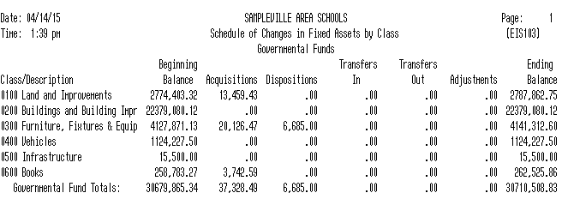
7
EIS103
+
-
+
-
+
=

Slide 8
EIS GAAP Reports
8
Totals by Fund Type on the EIS101, EIS102, and EIS103 should match when balancing out for the fiscal year-end.
Any errors reported on the EIS103E report should be resolved prior to closing the fiscal year.

Slide 9
EIS104
9
Contains changes in depreciation of fixed assets during the fiscal year
The EIS104 creates two reports as listed below:
EIS104S is a summary report listing the beginning depreciation, continuing items, acquisitions, dispositions, transfers, adjustments and ending depreciation balance in column format.
EIS104D is a detailed schedule of changes listing individual tags that make up the acquisitions, dispositions, transfers or adjustments amounts.
Reports will page break on each fund type: fiduciary, governmental, proprietary and undefined
The GAAP flag must be set to “Y” in order to generate a valid report.
For FYE, it is recommended to generate the report 3 different ways (AC, FC & FD); EISCD includes the 3 different ways
May be used as a depreciation balancing tool with the EIS305.

Slide 10
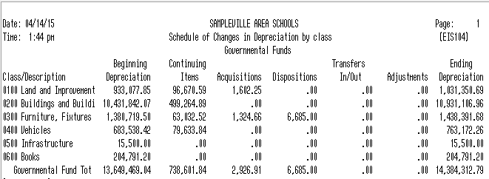
-
+
+
+
+
-
-
=

Slide 11
Suggested Non-GAAP Reports
11
EIS303 – Inventory Master Listing…..includes all data on file for items; VERY LARGE report – it can produce a complete listing of all items or specified subsets (i.e. report of just depreciation information); don’t recommend printing out a hard copy of the report.
EIS304 – Brief Asset Listing….. a one line per item listing of all items on file or subsets; EIS304 reports recommended to run at FYE…include capitalized items only and Status Codes of “A, N, EH, and EN” (with the exception of the disposition report).
Brief Asset Listing by fund
Brief Asset Listing by function
Brief Asset Listing by asset class
Acquisitions for current fiscal year
Dispositions for current fiscal year
Included in
EISCD

Slide 12
Suggested Non-GAAP Reports
12
EIS305 – Book Value (Depreciation) Report…..displays depreciation information listing original cost, salvage value, book value, % of depreciation, and last year of useful life.
The date 06/xxxx (where xxxx is FY being closed) is used for the reporting date. EIS305 reports recommended to run at FYE…include capitalized items only and Status Codes of “A, N, EH, and EN” (with the exception of the disposition report).
Book Value Report by function
Book Value Report by class
Depreciation for current FY dispositions by function
Depreciation for current FY dispositions by class
Included in EISCD

Slide 13
Suggested Non-GAAP Reports
13
EIS401 – Insurance Values Report…..lists insurable values and replacement cost information for items; insurable values listed reflect the insurance classifications assigned to the item categories in EISMNT/CATSCN; Recommended if the district maintains current replacement cost and/or insurable values on the inventory item records.
EIS801 – Audit Report…..tracks changes made to the EIS files
For FYE, select the Official Option and keep on file for the auditors… used as an official audit trail

Slide 14
Fiscal Year-End Closing Procedure
14
Run EISCD to generate a standardized set of FYE EIS reports.
HCC will make a copy of your EIS data files once you have completed the process. Please put in a Helpdesk ticket. Once you have received notice that this process has been completed then you can continue the closing process.

Slide 15
Fiscal Year-End Closing Procedure
15
Run EISCLS
Creates EISCLS.TXT which includes ending balances by Fund, Function and Asset Class. (These are the beginning balances for the next year)
Creates EISDEP.TXT which is a summary report of the current year’s depreciation, posted by fund.
Advances EIS last FY closed flag in EISMNT/DATSCN by one year
Adds one year’s worth of depreciation to LTD depreciation field
Updates beginning balance fields for new FY
Once EISCLS is complete, they may start entering inventory for the new fiscal year.

Slide 16
Fiscal Year-End Closing Procedure
16
If EIS GAAP flag is not turned on, HCC needs to assist in helping the district start up on GAAP by running EISGAAP.
EISGAAP: run only once and at the beginning of the GAAP startup year.
Sets GAAP flag in EISMNT/DATSCN to “Y”
Creates beginning information fields for each asset (EISITM.IDX)
Generates a beginning balance report for the GAAP startup year
Once EISGAAP is complete, they may start entering inventory for the new fiscal year.

Slide 17
17
Questions?

