Slide 1
USAS
FISCAL YEAR-END
CLOSING PROCEDURES
2020

Slide 2
PRE-CLOSING PROCEDURES
THE FOLLOWING STEPS MUST BE COMPLETED PRIOR TO CLOSING FOR FISCAL YEAR-END.
2

Slide 3
DISTRICT/BUILDING FINANCIAL DATA
THE DISTRICT FINANCIAL GENERAL INFORMATION AND BUILDING FINANCIAL INFORMATION MUST BE ENTERED THROUGH USAEMSDB. THIS DATA WILL BE REPORTED UNDER FINANCIAL REPORTING PERIOD H FOR FY20.

Slide 4
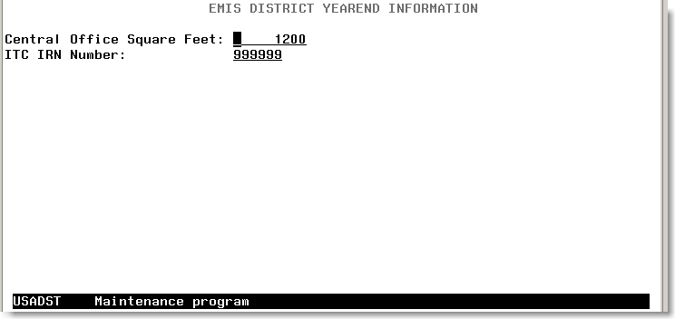
USAEMSDB - DSTMNT
Central Office Square Footage and ITC IRN are found in the USAEMSDB program option 1 - DSTMNT
4

Slide 5
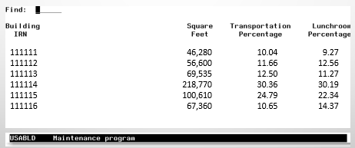
USAEMSDB - BLDMNT
The transportation and lunchroom percentages and correct square footage fields are found on the USAEMSDB program option 2.
5

Slide 6
USAEMSDB - BLDRPT
A report can be generated for the transportation, lunchroom percentages and building square footage under USAEMSDB option 3 - BLDRPT
6

Slide 7
VALACT
SHOULD BE RUN TO CHECK FOR ANY INVALID ACCOUNTS THAT MAY NEED TO BE FIXED PRIOR TO CLOSING FOR THE FISCAL YEAR.
THIS PROGRAM CREATES A REPORT OF INVALID ACCOUNTS WITH AN EXPLANATION AS TO WHY THE ACCOUNTS ARE CONSIDERED INVALID
WARNING MESSAGES WILL NOT CAUSE ANY PROBLEMS WHEN TRYING TO RUN YEAR-END PROGRAMS LIKE USAEMSEDT OR USAEMS
FATAL MESSAGES WILL PREVENT THE USAEMS SEQUENTIAL FILE FROM BEING CREATED
Notes:
7

Slide 8
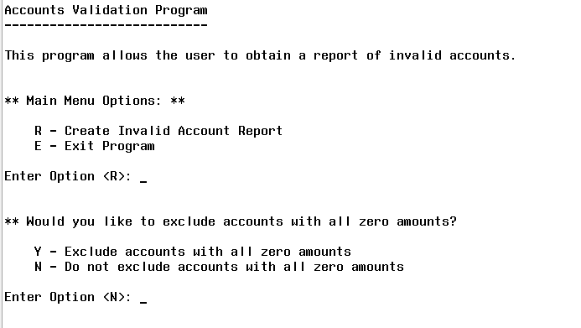
VALACT
All accounts will be validated, regardless of their active/inactive status or any start/stop dates, since inactive accounts may still have relevant amounts associated with them.
Accounts which have dollar amount fields that are all $0 will have their errors listed as warnings. If any amount field is non-zero, then the errors will be listed as fatals.
Choosing “Y” to exclude accounts with all $0 amounts may significantly reduce the number of warnings on your report
8
Notes:
8

Slide 9
VALACT MESSAGE
WARNING: ODE REQUIRES OPU TO BE ENTERED FOR THIS FUNC/OBJ PER EMIS GUIDE
FOR CERTAIN FUNCTION/OBJECT CODE PAIRINGS, A 000 OPU IS NOT ALLOWED. A WARNING IS ISSUED IF THE IRN RELATED TO THE OPU IS THE DISTRICT IRN
THESE FUNCTION/OBJECT CODE PAIRINGS HAVE BEEN IN SECTION 6.3 OF THE EMIS GUIDE FOR YEARS BUT SINCE ODE IS VALIDATING THEM IN THE DATA COLLECTOR, THE SAME VALIDATIONS WERE IMPLEMENTED IN USAS AND APPEAR ON VALACT AS WARNINGS.
ALSO, THESE OPUS WARNINGS WILL ONLY BE GENERATED FOR TRADITIONAL DISTRICTS THAT HAVE MORE THAN 1 BUILDING REPRESENTED IN THEIR OPU MASTER FILE. THE OPU WARNINGS WILL NOT BE GENERATED FOR ESC'S, CAREER CENTERS, COMMUNITY SCHOOLS OR ANY OTHER ENTITIES THAT ARE NOT EITHER A CITY, LOCAL, OR EXEMPTED VILLAGE DISTRICT TYPE.

Slide 10
EXAMPLE
VALACT warning:
02 200 4111 891 9001 000000 400 00 000 Warning: ODE requires OPU to be entered for this func/obj per EMIS Guide.
ART CLUB - EXPENSES
Entity
OPU Description IRN Type
001 SAMPLEVILLE - DISTRICT WIDE 011111
100 SAMPLEVILLE ELEM/MIDDLE SCHOOL 022222
200 SAMPLEVILLE HIGH SCHOOL 033333
300 SAMPLEVILLE CENTRAL OFFICE 011111 C
400 EXTRA CURRICULARS 011111
Chapter 6.3
41xx/8x0 must have OPU defined
EMIS guide states 41xx function with object 8X0 must have OPU defined (meaning OPU must be tied to building IRN#). In OPUEDT 400 is tied to district IRN. Leave as is and it will prorate expenses, otherwise if ART club expenses are tied to high school, ACTCHG the OPU to 200 so expenses will be tied to HS building IRN#
10

Slide 11
EMIS FUND CATEGORIES
VALACT
LISTS ERRORS FOR INVALID FUND CATEGORIES
EMISFCAT REPORT
LISTS ALL FUNDS AND ASSOCIATED FUND CATEGORY
ENTER “NOT APPLICABLE” ON THE CASH ACCOUNT IF NO APPROPRIATE CODE EXISTS
* Current ODE EMIS Manual - Section 6.2 Cash Record (QC)
11

Slide 12
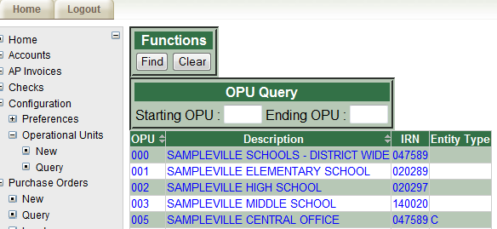
OPERATIONAL UNITS
CHECK OPERATIONAL UNITS
USE USASWEB/ OPERATIONAL UNITS TO QUERY ALL THE OPUS; AND MAKE MODIFICATIONS IF NEEDED
OPU OF 000 HAS TO EQUAL THE REPORTING DISTRICT IRN; THIS IS THE DISTRICT-WIDE OPU AND SHOULDN’T BE USED TO IDENTIFY A SPECIFIC BUILDING
12
Notes:
12

Slide 13
APPROPRIATIONS
NEXT YEAR ESTIMATED BUDGETS AND REVENUES MAY BE ENTERED INTO THE NEXT YEAR PROPOSED FIELDS THROUGH APPROP PRIOR TO RUNNING FISCAL YEAR-END ADJUST.
NOTE: ALTERNATIVELY, IABMASS, IABMNT, OR IABLOAD (ALSO PART OF APPROP) MAY BE USED AFTER CLOSING THE FISCAL YEAR
13

Slide 14
APPROPRIATIONS
NYPINI…CLEARS OUT ANYTHING CURRENTLY IN THE NEXT YEAR PROPOSED FIELDS
NYPMASS…ALLOWS RANGES OF ACCOUNTS TO BE MASS UPDATED BASED ON THE CALCULATION METHOD CHOSEN
NYPMNT…ENTER NEXT YEAR PROPOSED AMOUNTS INDIVIDUALLY
NYPLOAD…UPLOAD NEXT YEAR PROPOSED AMOUNTS VIA A SPREADSHEET FILE
14

Slide 15
MONTH-END CLOSING

Slide 16
MONTH-END CLOSING
FOLLOW NORMAL PROCESS OF CLOSING OUT FOR THE MONTH
AFTER ALL TRANSACTIONS HAVE BEEN ENTERED, RECONCILE USAS WITH THE BANK
BALCHK TOTALS SHOULD BE IN BALANCE
ENSURES ALL UNDERLYING ACCOUNTS ARE IN BALANCE WITH THE ASSOCIATED CASH ACCOUNT
CURRENT ENCUMBERED FROM BALCHK SHOULD BALANCE WITH PODETL
CASH RECONCILIATION FROM USAEMSEDT SHOULD BALANCE WITH FINSUMM
16

Slide 17
MONTH-END CLOSING
FINSUMM NEEDS TO BALANCE WITH FINDET
FIGURES ARE COMING FROM 2 COMPLETELY DIFFERENT AREAS
FINSUMM PULLS AMOUNTS FROM THE ACCOUNT FILE
FINDET PULLS AMOUNTS FROM THE DETAILED TRANSACTION FILES
IF THE 2 DO NOT BALANCE, MEANS SOMETHING DID NOT GET COMPLETELY UPDATED DURING PROCESSING
RUN SM2 CALC OPTION IF TRACKING SM2 FIGURES
REVIEW REPORT FOR ACCURACY
OPTIONAL – ALSO RUNS AUTOMATICALLY AS PART OF ADJUST
17

Slide 18
MONTH-END CLOSING
GENERATE ANY MONTH-END REPORTS DESIRED
MINIMUM REPORTS RECOMMENDED ARE:
BUDSUM, APPSUM, AND REVSUM
DETAILED PODETL
FINSUMM & FINDET
RECLED
DETAILED CHEKPY
CASH RECONCILIATION (USAEMSEDT)
MAY BE GENERATED VIA MONTHLYCD
GENERATES STANDARD SET OF MONTHLY REPORTS
CAN BE MADE AVAILABLE VIA SECURE WEB SITE
CAN BE ARCHIVED TO CDROM
18

Slide 19
FISCAL YEAR-END CLOSING

Slide 20
FISCAL YEAR-END CLOSING
COMPLETE THE REST OF THE USAEMSEDT OPTIONS
EACH OPTION MUST AT LEAST BE ENTERED AND EXITED EVEN IF THERE IS NOTHING TO ENTER
EACH DATA ENTRY OPTION HAS THE ABILITY TO GENERATE A REPORT
CAN BE VERY USEFUL TO GENERATE THE REPORT TO SEE WHAT HAS BEEN CARRIED OVER FROM THE PRIOR YEAR FOR EACH OPTION
20

Slide 21
USAEMSEDT PROCESSING
*** Main Menu ***
1 - Cash Reconciliation
2 - Federal Assistance Programs - Summary
3 - Federal Assistance Programs - Detail
4 - Civil Proceedings
5 - Exit Program
***System Manager Only***
6 - Change flags
Enter option < 5>: _

Slide 22
OPTION 1 - CASH RECONCILIATION
ENTER ALL BANK AND ENDING BALANCES
ENTER ANY DEPOSITS IN TRANSIT
ENTER OUTSTANDING CHECKS
ENTER ANY ADJUSTING ENTRIES
LIST INVESTMENTS
BONDS & NOTES
CD’S
SECURITIES
OTHER INVESTMENTS
LIST CASH ON HAND
(EX: PETTY CASH)
OUTPUT FILE = CSHREC.TXT
22

Slide 23
OPTION 1 - CASH RECONCILIATION
FIGURES ENTERED MUST BALANCE WITH THE CURRENT FUND BALANCE AS REPORTED ON THE FINSUMM
NOT IN BALANCE IF THE FOLLOWING IS DISPLAYED WHEN EXITING OPTION 1
Total entered in option 1
Total on the account file
23

Slide 24
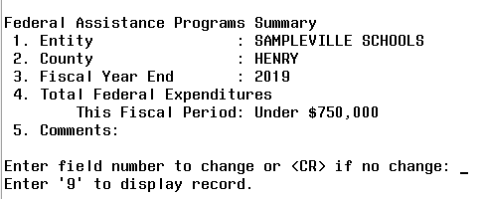
OPTION 2 – SUMMARY FEDERAL ASSISTANCE PROGRAMS
FEDSUM.TXT
FEDERAL ASSISTANCE SUMMARY
ASKS THE FOLLOWING INFORMATION:
SOURCE DOCUMENT – FINSUMM FOR FEDERAL FUNDS ONLY, PLUS ANY OTHER FEDERAL ASSISTANCE RECEIVED
24

Slide 25
OPTION 3 – DETAIL FEDERAL ASSISTANCE PROGRAMS
FEDDET.TXT
CONTAINS AN INITIALIZATION OPTION
DELETES PRIOR YEAR INFORMATION FOR 5XX FUNDS
CREATES NEW RECORDS BASED ON CURRENT YEAR FIGURES FOUND ON THE ACCOUNT FILE FOR 5XX FUNDS
CFDA # FOR EACH RECORD CREATED WILL NEED TO BE ENTERED
RECORDS FOR ANY FUNDS OTHER THAN 5XX WILL ALSO NEED TO BE MANUALLY ENTERED OR UPDATED
25

Slide 26
OPTION 3 – DETAIL FEDERAL ASSISTANCE PROGRAMS
SUGGESTED SOURCE DOCUMENTS
ODE WEB SITE SUMMARY REPORT OF AMOUNT OF FEDERAL CONTRIBUTIONS RECEIVED FROM ODE
CFDA #’S ARE LISTED ON THE PRINTOUT FROM THE ODE WEBSITE AND ARE IN AOS USAS MANUAL
26

Slide 27
OPTION 4 – CIVIL PROCEEDINGS
CVLPRC.TXT
ENTER DATA FOR ANY LAW SUITS DURING REPORTING PERIOD
27
Notes:
27

Slide 28
FINANCIAL DATA REPORTING
DATA IS TO BE REPORTED TO ODE VIA EMIS-R
REPORTING PERIOD H
DATA TYPES CONSIST OF:
CASH, BUDGET, AND REVENUE ACCOUNTS
OPERATIONAL UNIT CODES
DATA ENTERED IN USAEMSEDT
DATA ENTERED IN USAEMSDB
28
Notes:
28

Slide 29
USAEMS
EXTRACTS DATA FROM THE USAEMSEDT AND USAEMSDB PROGRAMS AND STORES IT IN A FLAT-FILE LAYOUT TO BE LOADED INTO EMIS-R
CHECKS ALL NECESSARY FUNDS ARE CODED WITH A VALID EMIS FUND CATEGORY
29
Notes:
29

Slide 30
USAEMS cont…
ALSO CHECKS ALL USAEMSEDT OPTIONS HAVE BEEN COMPLETED
WARNING MESSAGE ISSUED IF CASH RECONCILIATION NOT IN BALANCE OR CONTAINS ERRORS
WARNINGS MESSAGES ISSUED IF ANY OF THE OPTIONS AREN’T COMPLETED
FATAL MESSAGE ISSUED IF FEDERAL ASSISTANCE DETAIL RECORD DOES NOT CONTAIN CFDA NUMBERS
FATAL MESSAGE ISSUED IF FEDERAL ASSISTANCE SUMMARY RECORD’S FISCAL YEAR IS NOT THE CURRENT FISCAL YEAR
30
Notes:
30

Slide 31
USAEMS cont…
CREATES TWO OUTPUT FILES:
USAEMS_EMISR.SEQ (PARTIAL OUTPUT FILE) *DISTRICTS LOADS INTO EMIS-R*
USAEMS.SEQ (FULL OUTPUT FILE) *DO NOT LOAD INTO EMIS-R UNLESS LOADING ITC DATA*
31
Notes:
31

Slide 32
USAEMS_EMISR.SEQ
PARTIAL OUTPUT FILE THAT INCLUDES:
CASH RECONCILIATION
FEDERAL ASSISTANCE SUMMARY AND DETAIL
CIVIL PROCEEDINGS
DISTRICT AND BUILDING PROFILE INFORMATION
WILL EXCLUDE THE ACCOUNT AND OPERATIONAL UNIT RECORDS.
MUST BE UPLOADED INTO THE DATA COLLECTOR TO BE USED ALONG WITH THE USAS SIF AGENT FOR EMIS-R COLLECTIONS.
USAS SIF AGENT PULLS THE FOLLOWING FROM LIVE USAS DATA:
CASH, EXPENDITURE, REVENUE ACCOUNTS
ACCOUNT DATA WILL BE PULLED EITHER FROM THE CURRENT YEAR DATA OR FROM ACCOUNT HISTORY DATA DEPENDING ON THE TIMING OF WHEN THE EMIS-R DATA COLLECTION IS RUN.
OPERATIONAL UNITS
32

Slide 33
USAEMS.SEQ
FULL FILE CONTAINING ALL RECORD TYPES NEEDED FOR EMIS-R REPORTING (EXCEPT CAPITAL ASSETS).
DISTRICTS SHOULD NOT BE UPLOADING USAEMS.SEQ FILE. INSTEAD, THEY SHOULD BE UPLOADING THE PARTIAL FILE (USAEMS_EMISR.SEQ). THEN WHEN COLLECTING THE DATA, THEY WILL SELECT THE “FINANCIAL” DATA SOURCE ALONG WITH THE USAS SIF AGENT.
33
Notes:
33

Slide 34
USAEMS
USAEMS - Extract financial data into EMIS-R detail file format.
Are you extracting for an Information Technology Center? (Y,N,?) <N> _
District IRN: 123456
District Name: SAMPLEVILLE SCHOOLS
Is this correct? (Y,N,?) <Y> _
Enter Fiscal Year: <2020> ____
Continue, Re-enter, or Exit? (C,R,E,?) <C> _
Processing, please wait!
Full output file is USAEMS.SEQ
Partial output file is USAEMS_EMISR.SEQ
Processing Completed!
34

Slide 35
USASAUD
RUN THE USAS AUDITOR EXTRACTION PROGRAM
ANSWER “Y” TO “SEND DATA TO AOS NOW”; SENDS ACCTAUD.SEQ, VENAUD.SEQ, TRANAUD.SEQ AND FINSUMM
EXTRACTS INFORMATION FROM THE ACCOUNT, VENDOR, CHECK, AND RECEIPT DATA FILES FOR AUDITING PURPOSES
CREATES ACCTAUD.SEQ, VENAUD.SEQ,TRANAUD.SEQ FILES, AND FINSUMM (SORTED BY FUND)
ALSO CREATES ACCTAUD, VENAUD, TRANAUD AND FINSUMM TEXT FILES
DETAILS INFORMATION SENT TO AOS VIA THE SEQUENTIAL FILE
35
Notes:
35

Slide 36
FISCAL YEAR-END REPORTS
GENERATE ANY FISCAL YEAR-END REPORTS DESIRED
MAY BE GENERATED VIA FISCALCD
GENERATES STANDARD SET OF FISCAL YEAR REPORTS
CAN BE MADE AVAILABLE VIA SECURE WEB SITE
CAN BE ARCHIVED TO CDROM
36

Slide 37
FISCAL YEAREND ADJUST
WHAT HAPPENS? ACCOUNTS
AMOUNTS MOVED TO USAHIST FILE
CURRENT FUND BALANCE MOVED TO JULY 1ST CASH BALANCE
FUTURE YEAR ENCUMBERED ADDED TO FUTURE ENCUMBERED THEN CLEARED
FUTURE YEAR REQUISITIONED ADDED TO REQUISITIONED AMT THEN CLEARED
NEXT YEAR PROPOSED MOVED TO INITIAL BUDGET/REV. AND THEN CLEARED
CURRENT ENCUMBRANCES MOVED TO CARRYOVER ENCUMBRANCES
FISCAL-TO-DATE AMOUNTS CLEARED
CALCULATED FIELDS RECALCULATED
GAAP ORIGINAL FIELDS SET TO NEW EXPENDABLE/RECEIVABLE
37

Slide 38
FISCAL YEAREND ADJUST cont…
WHAT ELSE HAPPENS?
VENDORS
FISCAL-TO-DATE AMOUNT CLEARED
USASDAT/USACON
CURRENT FISCAL YEAR UPDATED
SM2/ADJUST MONTHLY ACCESS FLAGS CLEARED
38

Slide 39
FISCAL YEAREND ADJUST cont…
CRITCALLY IMPORTANT
When you are ready to close the Fiscal Year,
DO NOT run Fiscal Year End Adjust!
HCC will run FYE Adjust after creating a Backup of your data.
Send email to HCC Helpdesk to request “USAS Backup & FY Close” and please include a phone number where you may be reached.
financesupport@mail.hccanet.org
39

Slide 40
FINANCIAL REPORTING SPECIAL NOTES
DISTRICTS SHOULD NOT UPLOAD USAEMS.SEQ FILE. THEY ONLY NEED TO UPLOAD THE USAEMS_EMISR.SEQ FILE IN THE “FINANCIAL” DATA SOURCE IN EMIS-R. WHEN THEY ARE READY TO RUN A COLLECTION, THEY WILL SELECT THE USAS SIF AGENT AND THE “FINANCIAL” DATA SOURCE.
THERE IS AN “EMIS REPORTING YEAR” FLAG IN USASDAT/USACON THAT TELLS THE SIF IF IT SHOULD PULL ACCOUNT INFORMATION FROM THE HISTORY RECORDS OR THE CURRENT ACCOUNT FILE
SSDT STRONGLY RECOMMENDS DISTRICTS HOLD OFF MAKING ANY UPDATES TO THEIR OPUS, ACCOUNTS (I.E. ACTCHG/FNDCHG) OR DELETING ACCOUNTS IN FY21 UNTIL AFTER THEY HAVE COMPLETED THEIR EMIS-R REPORTING FOR FY20 PERIOD H.
40

Slide 41
PERIOD H
ODE HAS DRAFT SCHEDULE POSTED ONLINE. -
NOTE HIGHLIGHTED CHANGES
41
Notes:
41

Slide 42
POST-CLOSING PROCEDURES
Notes:
42

Slide 43
EMIS-R
THE FINANCIAL DATA SUBMISSION PROCESS IS DONE THROUGH EMIS-R AND IS UNDER DISTRICT CONTROL RATHER THAN ITC CONTROL. AN AUTHORIZED PERSON IN THE DISTRICT (EMIS COORDINATOR, TREASURER, ETC.) WILL NEED TO UPLOAD THE FLAT FILE, RUN THE DATA COLLECTION PROCESS, AND SUBMIT THE DATA TO ODE.
MUST BE SENT TO ODE BEFORE PERIOD 20H CLOSES
43
Notes:
43

Slide 44
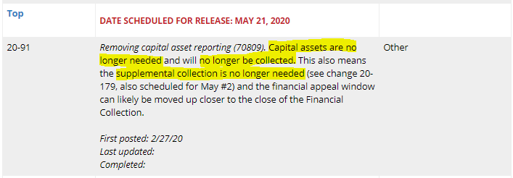
CAPITAL ASSETS REPORTING CHANGES FOR FY20
EMIS Changes - noted on ODE website -last updated 4/10/20
44

Slide 45
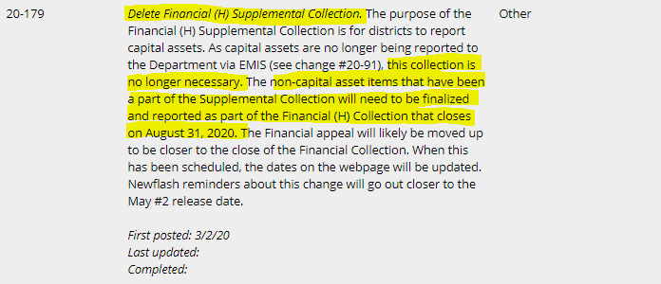
CAPITAL ASSETS REPORTING CHANGES FOR FY20 cont…
45

Slide 46
GAAP CONVERSION
RUN USAEXP’S GAAP_EXP OPTION TO CREATE NECESSARY FILES FOR GAAP REPORTING
CAN BE RUN EITHER BEFORE OR AFTER CLOSING OUT
CREATES FILE (GAAPEXP.TXT) TO BE UPLOADED INTO WEBGAAP
EMAILS GAAPEXP.TXT TO SPECIFIED EMAIL ADDRESS FOR UPLOADING INTO WEBGAAP
46

Slide 47
USAEXP GAAP_EXP
47

Slide 48
WEBGAAP
GAAP URL
HTTPS://GASB34SYS.AUDITOR.STATE.OH.US/GAAP
GAAP WIKI
HTTP://GAAPWIKI.OECN.K12.OH.US/INDEX.PHP?TITLE=MAIN_PAGE
48

Slide 49
QUESTIONS?
financesupport@mail.hccanet.org
Finance Team 513-728-7999
Terri Dobbs 513-728-7920
Catherine Bach 513-728-7922
49

